Slide 1
Learning Developmental Neurobiology with BrainSpan
Daniel Keitley
Cambridge Bioinformatics Hackathon 2018

Slide 2
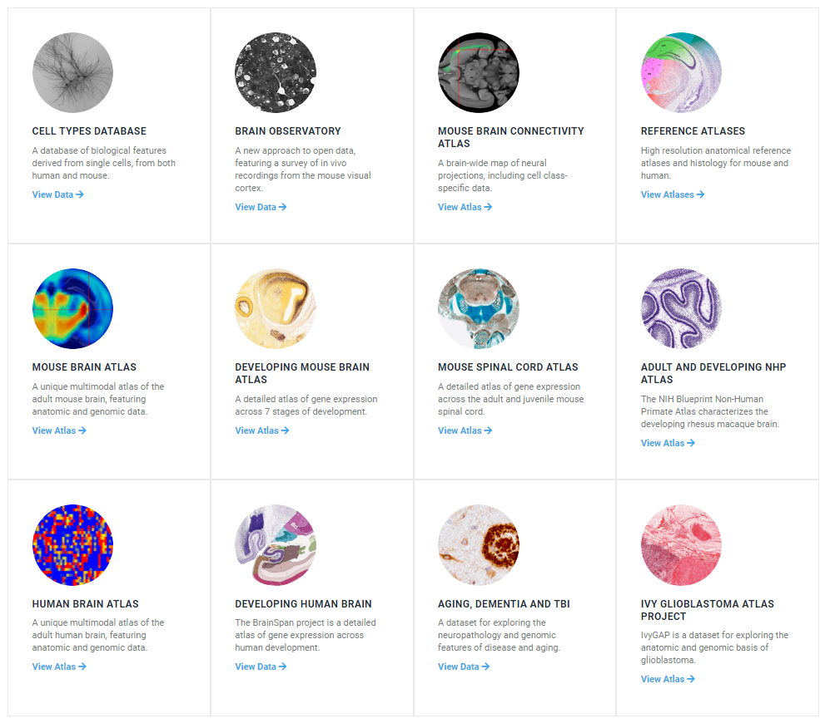
Motivation
Explore the Allen Brain Atlases
Create visualisations/an education resource for learning about developmental neurobiology using real data.
Validate experimental research – reproduce findings from literature

Slide 3
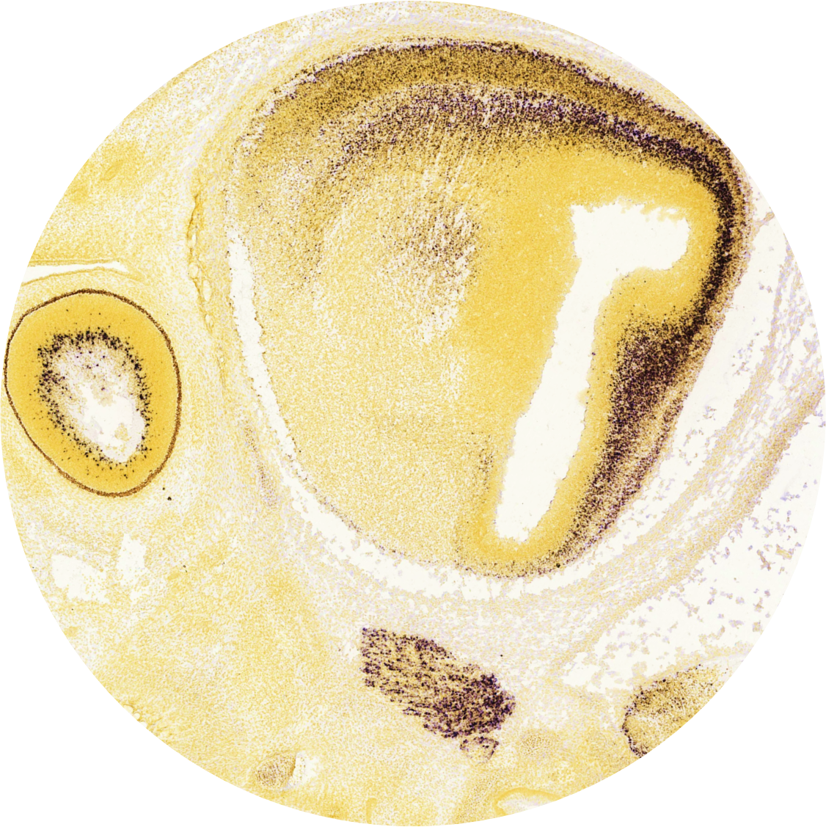

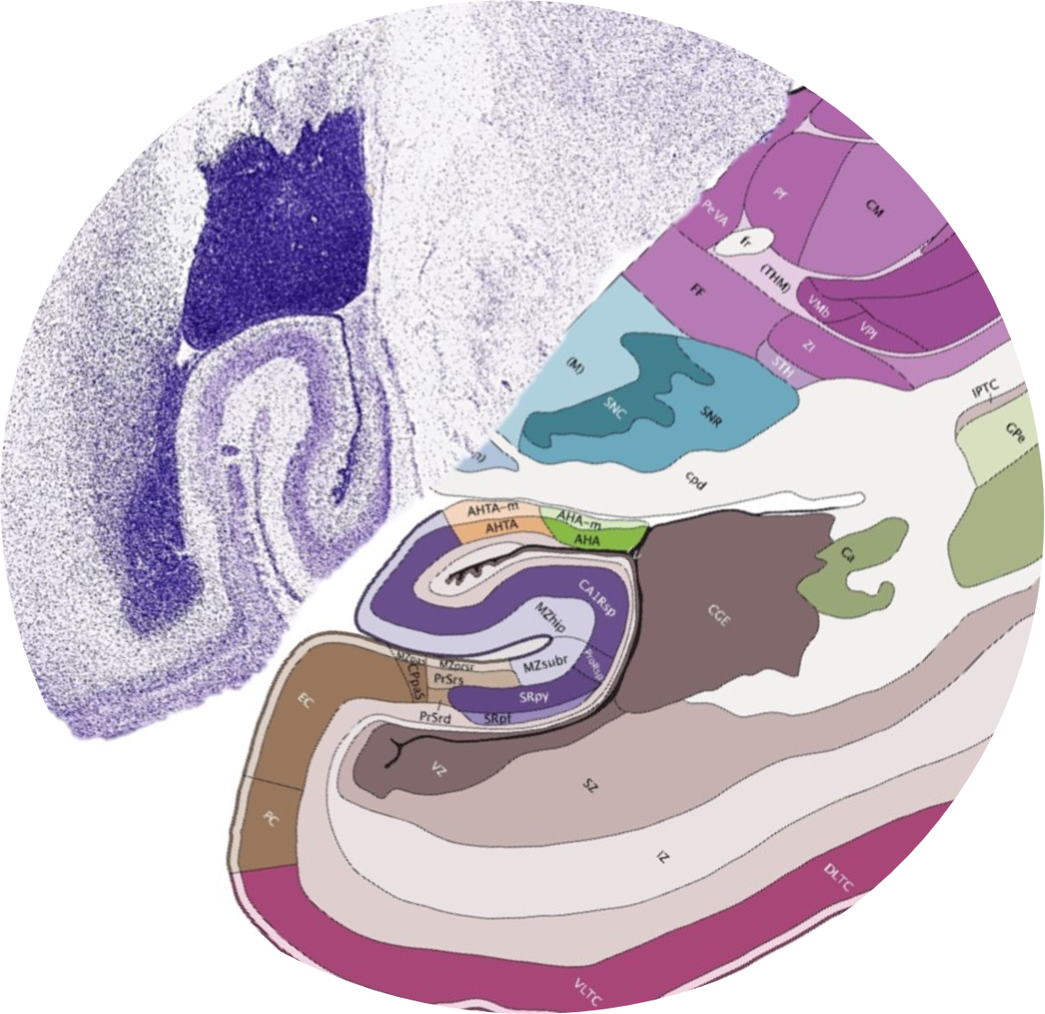
Tools
BrainSpan
Transcriptome, Microarray, ISH data from various developmental stages from human brain.
http://www.brainspan.org/
Developing Mouse Brain Atlas
3D gene expression data and ISH data across developmental stages in mouse.
http://developingmouse.brain-map.org/
Google Colab
Google docs for writing/running python code.
Run, experiment and collaborate with python code in the browser.

Slide 4
Some results…

Slide 5
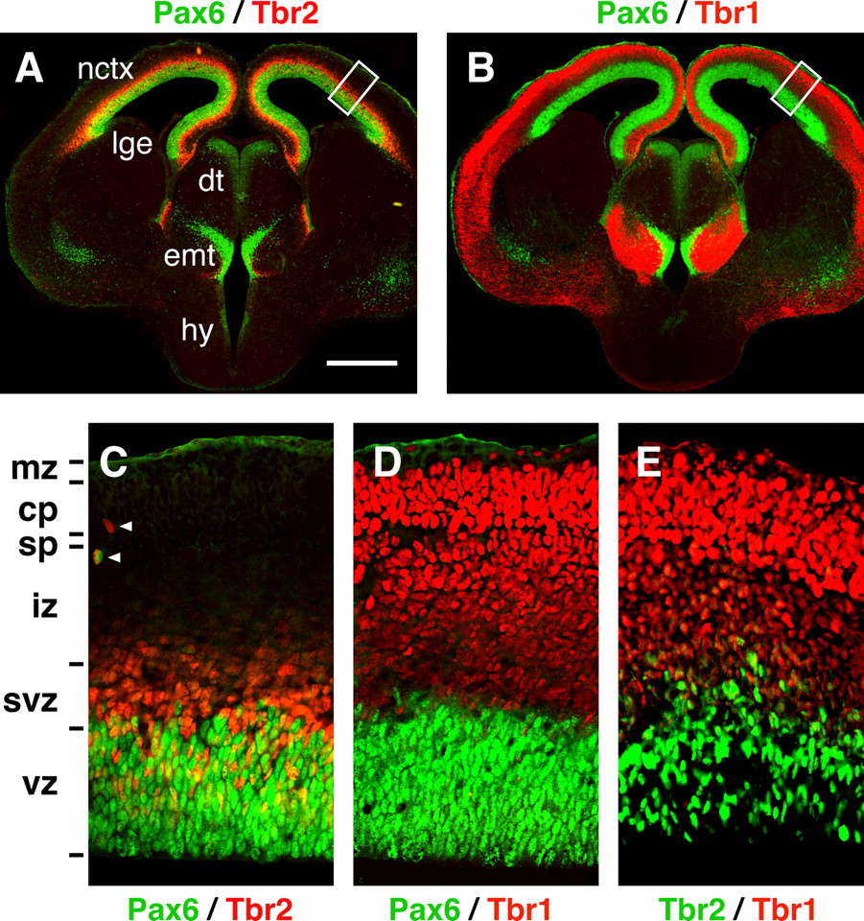
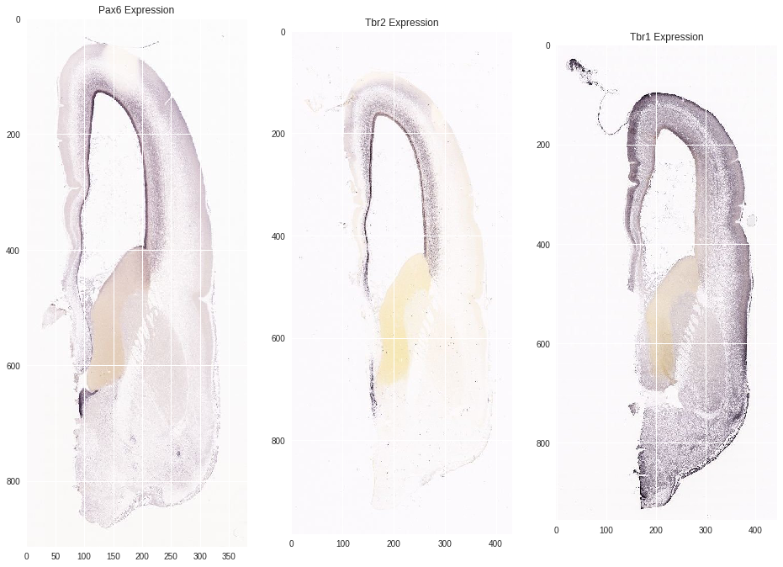
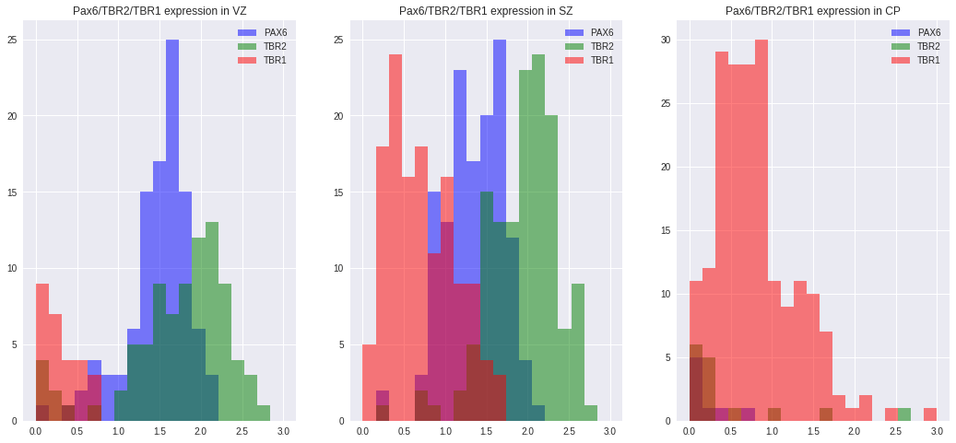
Neurogenesis
BrainSpan Data
ISH data shows Pax6 and Trb2 close to VZ whereas Tbr1 predominantly in upper cortical areas in 15pcw old human brain.
Literature
Microarray data in 15pcw and 21pcw humans show higher expression of Tbr1 in CP, Tbr2 in SVZ and VZ. Similar expression patterns to literture.
Comparing 15pcw and 21pcw expressions may reveal finer details.
Differentiation of radial glia to produce pyramidal neurons thought to triggered by sequential expression of Pax6->Tbr2->Tbr1 in developing cortex.
Pax6 expression localised to ventricular zone (VZ), Tbr2 also in the subventricular zone (SVZ) and Tbr1 in the upper cortical areas (e.g. cortical plate).
Englund, Chris, Andy Fink, Charmaine Lau, Diane Pham, Ray A. M. Daza, Alessandro Bulfone, Tom Kowalczyk, and Robert F. Hevner. 2005. “Pax6, Tbr2, and Tbr1 Are Expressed Sequentially by Radial Glia, Intermediate Progenitor Cells, and Postmitotic Neurons in Developing Neocortex.” The Journal of Neuroscience: The Official Journal of the Society for Neuroscience 25 (1): 247–51.

Slide 6
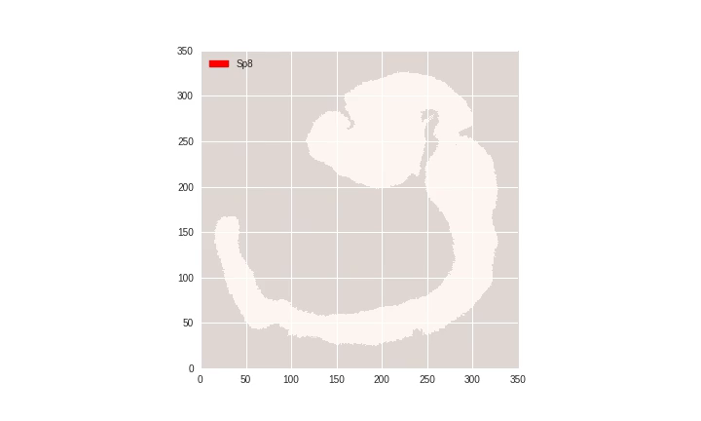
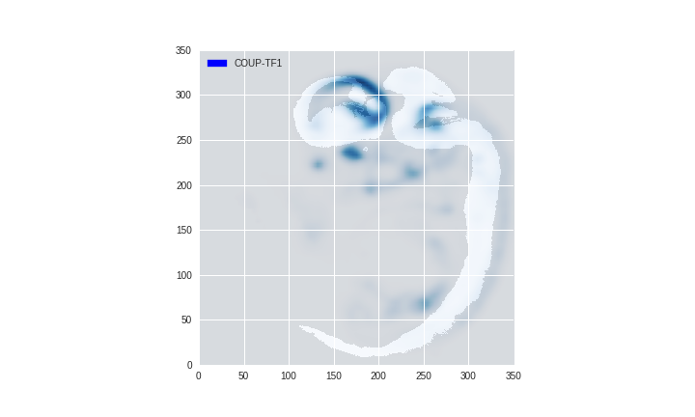
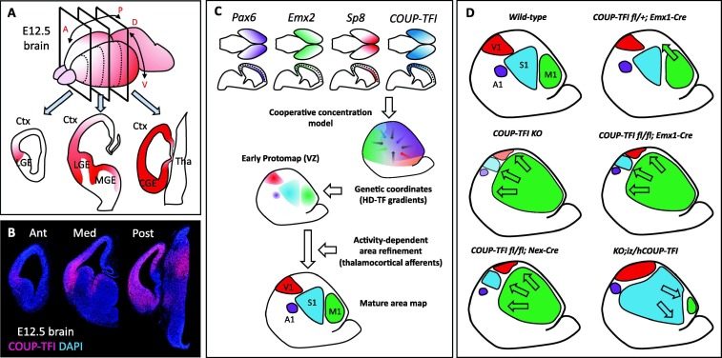
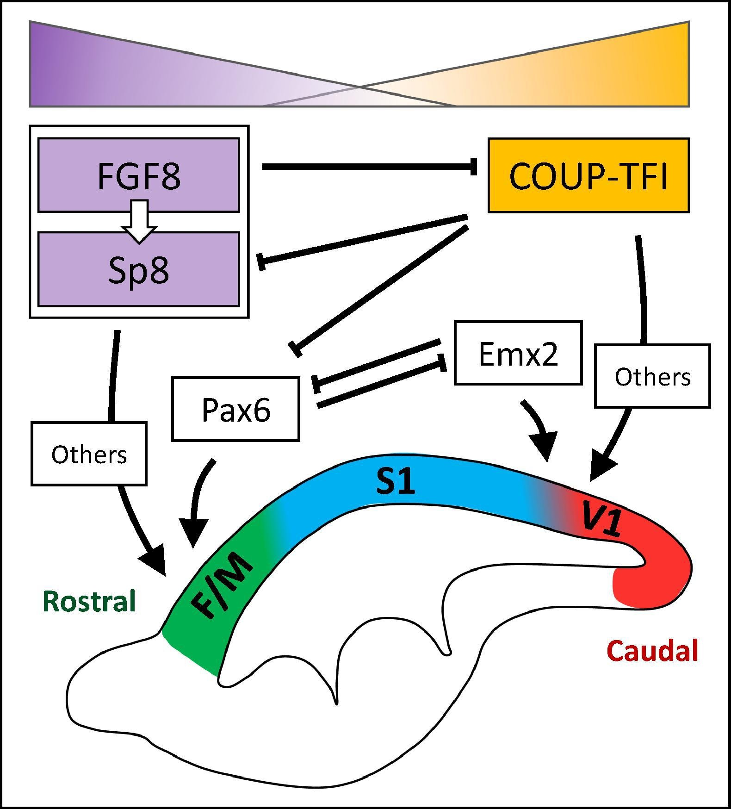
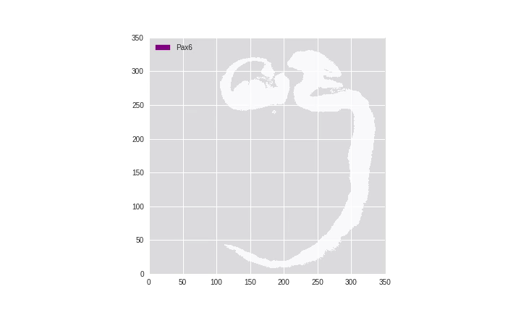
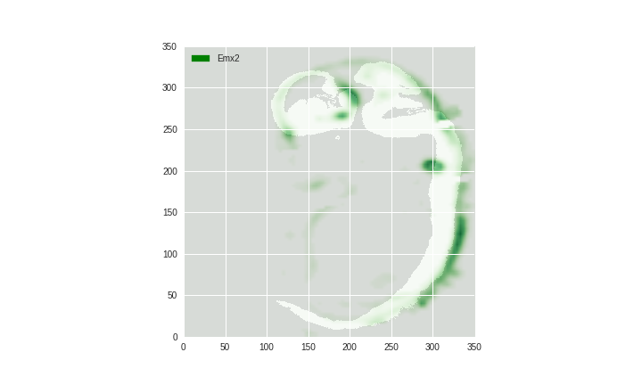
Cortical Arealisation
Developing Mouse Brain Atlas
Animations of gene expression in sequential sagittal brain slices.
Some patterns more convincing than others!
May require looking closer at different development stages (Sp8 video is 11.5 days, others 13.5 days).
Gene expression spatial mapping not 100% accurate. Background image is a reference.
Literature
Cortical areas initially specified by transcription factor gradients and then refined by neural activity.
Pax6 and Sp8 concentrated rostrally, COUP-TF1 and Emx2 caudally.
Bertacchi, Michele, Josephine Parisot, and Michèle Studer. 2018. “The Pleiotropic Transcriptional Regulator COUP-TFI Plays Multiple Roles in Neural Development and Disease.” Brain Research, April. https://doi.org/10.1016/j.brainres.2018.04.024.

Slide 7
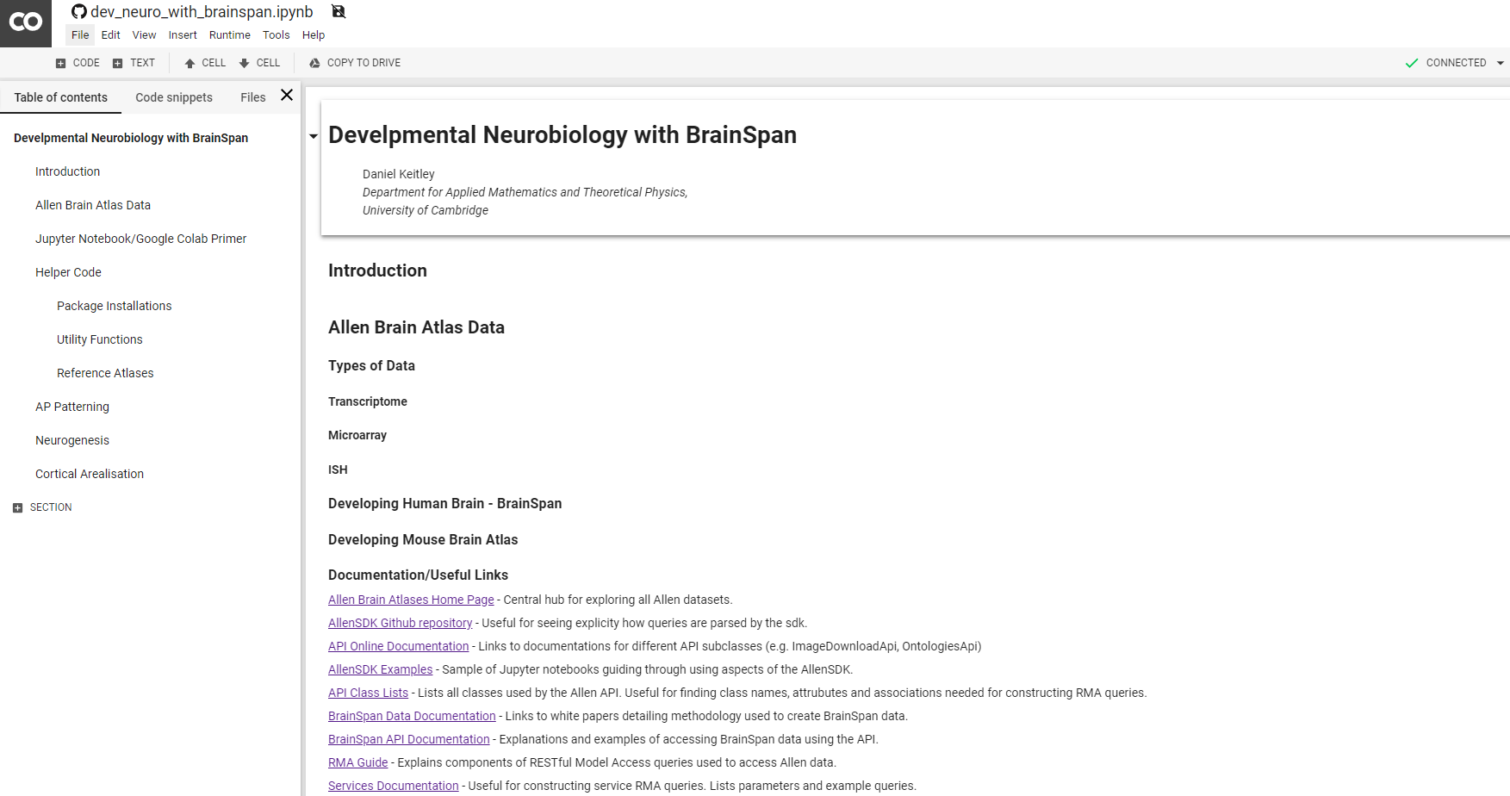
Summary
Explored and understood the Allen Brain Atlases datasets and API.
Created a tool for learning about and exploring gene expression through development using Google Colab. Generalised functions for querying data on any gene through multiple developmental stages and brain structures in human and mouse.
Investigated known gene expression patterns in the literature.
Head over to my Github repository to try the code out for yourself!
https://github.com/dkeitley/dev-neuro-brainspan/blob/master/dev_neuro_with_brainspan.ipynb

